Slide 1
An Order Handling System
Group 4

Slide 2
Requirements
Design the order handling functionality for a different type of an online shopping site
that transmits orders to different order fulfilling companies based on the
type of the goods ordered.
Suppose that the group of order handling companies can be classified into three
categories based on the format of the order information they expect to receive.
These formats include comma-separated value (CSV), XML and a custom object.
“When the order information is transformed into one of these formats”,
appropriate header and footer information that is specific to a format needs to
be added to the order data.
The series of steps required for the creation of an Order object can be summarized as follows:
Create the header specific to the format
Add the order data
Create the footer specific to the format

Slide 3
Actors
Online Shopping Site
Order Handling Company
Order Fulfilling Company

Slide 4
Use Case Diagram
Order Handling System
Send Order Object
<<include>>
Order Fulfilling Company
Online Shopping Site
Make Order
<<include>>
<<include>>
Make Order Object
Classify Order Type
Order Handling Company
Notes:
classify order type
take in type
return format
make plain order
get order from site
include: classify order format
include: make order object
include: send order object

Slide 5
Make Order [UC1]
Requirements : R1
Description : Online Shopping Site sends a plain order to the order handling system
Actor : Online Shopping Site
Basic Flow : [BF1]
Online Shopping Site sends the plain text version of an order to the order handling system
Include [UC2] to transform the plain text to a specific format (including CSV, XML, and a Custom Object)
Include [UC3] to forward the specific format to the specific Order Handling Company in order to add some information
Include [UC4] to transmit the Order Object to Order Fulfilling Company
Alternative Flow [AF1]:
Online Shoping Site can’t make the order, back to [BF1.1].

Slide 6
Classify Order Type [UC2]
Requirements: R2
Description: The order handling system classifies the type of the order sent from Online Shopping Site.
Actor: None
Basic Flow [BF2]:
The order handling system receives the order from Online Shopping Site.
The order handling system scans the information of the order.
The order handling system recognizes the type of the order.
The order handling system returns the format of the order.
Alternative Flow [AF2] :
The information of the plain order concerning the type is invalid or missing, back to [BF1.1]

Slide 7
Make Order Object [UC3]
Requirements: R3
Description: The order handling system can create different types of Order objects by delegating to different Order Handling Companies.
Actor: Order Handling Company
Basic Flow [BF3]:
The order handling system gets the format [UC2].
The order handling system sends the specific format to the corresponding Order Handling Company.
After the Order Handling Company builds the complete Order object, it returns the Order object to the order handling system.
Alternate Flow [AF3]:
[AF3.1] The returned Order object is invalid, the system sends an error message to Online Shopping Site.

Slide 8
Send Order Object [UC4]
Requirements : R1
Description : Transmit orders to respective Order Fulfilling Companies based on the type of the ordered goods.
Actor : Order Fulfilling Company
Basic Flow : [BF4]
Get the Order object from Make Order.
Analyze the Order object and extract the type of the goods from the Order object
Look up the corresponding Order Fulfilling Company to which the type of each good belongs.
Send an order of the good to Order Fulfilling Company.
Alternate Flow [AF4]
If Order Fulfilling Company is out of stock for the good, exit, and send a message to Online Shopping Site.

Slide 9
Scenarios
Scenario ID | Description | Flow | Ending State
S1 | The order is sent to Order Fulfilling Company successfully. | BF1 BF2 BF3 BF4 | end
S2 | The system fails to make the order. | BF1 AF1 | end
S3 | The system fails to classify the order type. | BF1 BF2 AF2 | end
S4 | The system fails to make the order object. | BF1 BF2 BF3 AF3 | end
S5 | The system fails to send the order. | BF1 BF2 BF3 BF4 AF4 | BF4

Slide 10
Test Cases
Scenario | Order Type | Format | Order Handling Company | Order Object | Enough stocks | Expected Result
S1 | Valid | Valid | Valid | Valid | Valid | Success
S2 | N/A | - | - | - | - | Cannot make order
S3 | Invalid | - | - | - | - | Cannot find type
S4 | Valid | Valid | Valid | Invalid | - | Order object , back to BF2
S5 | Valid | Valid | Valid | Valid | Invalid | Cannot transmit the order.

Slide 11
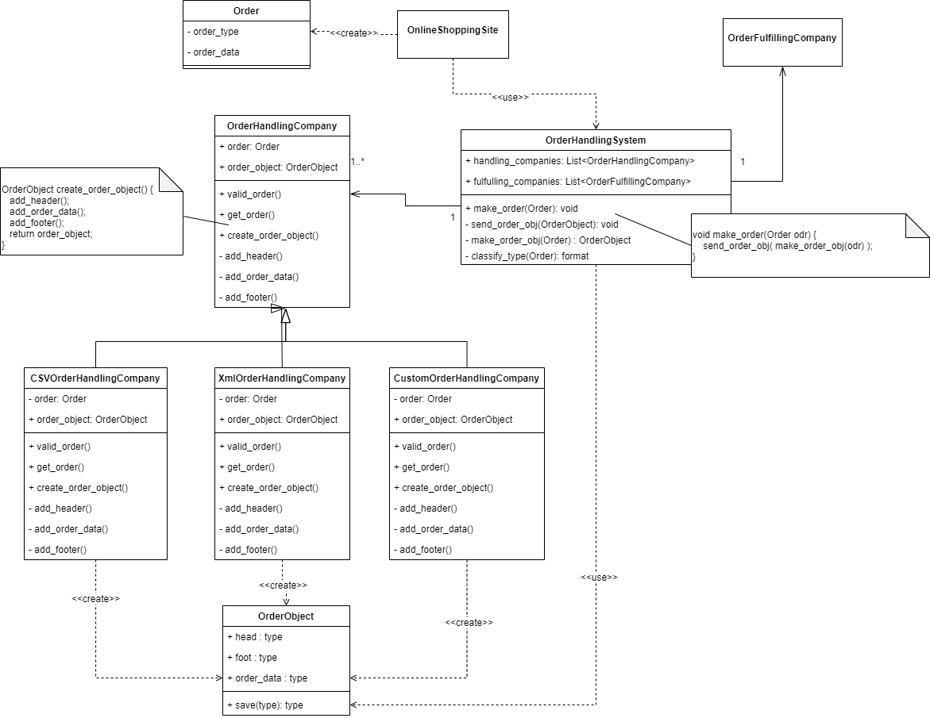
Class diagram

